Slide 1

OPPORTUNITIES IN EMERGING MARKETS
Sept 11, 2020
www.antler.co
Notes:
Data-driven way to inspire the ideation process

Slide 2
EXECUTIVE SUMMARY
AMBITION
We set out to understand two things about Emerging Markets
What verticals and problems received venture capital funding in emerging markets historically?
Was there a trend in the succession in which problems were solved when emerging markets were at a comparable stage to today’s Africa?
FINDINGS
We looked for historical lessons in Asia and Latin America: we found India circa 2005 to be the closest comparable to Africa today based on selected macro indicators
In pre-2000s India Finance overshadowed Commerce; post-2000s Commerce had taken up 4x in funding with solutions masking/solving multiple verticals/value additions
Other sectors have also attracted funding over time, but winning solutions seem to be further in between
We also noted that purely macro indicators-based comparisons do not account for fact that:
The Internet has replaced older infrastructure giving Africa today an edge to leapfrog
The world is no longer flat -- African customers today have higher expectations based on what they perceive to be global global service standards
CONCLUSION
Africa doesn’t have to reinvent the wheel -- it can look at winning solutions and adapt them to Africa’s context
Importing product/market fit from other countries should be done with caution (e.g. Careem/Uber in MENA is a good example both how to win/lose)
Notes:
Data-driven way to inspire and work with ideation.
Ambition
What verticals and problems received VC: i.e what problems were found to be exciting solve in other markets, i.e. through their presumed ability to unlock economic value
Trend in succession: i.e what solution to one problem, enabled another problem to be solved. (.e.g if you want to copy paste Jumia in Africa, then logistics needs to be a non-issue, consumers have to be online & with spending capacity,
Findings
We found that india in 2005 is the closest comparable on a set of macro indicators, so we thought it would be interesting to look at their development starting around that year
Finance v Commerce
Macro-indicators not painting the full picture -> infrastructural differences between india 2005 and kenya now plays a huge role. i.e. there are a lot of opportunities in African countries today for leapfrogging.
The world is not flat: tied to leapfrogging,
Conclusion:
There are definitely trends and similarities. Thus we can look at what problems were most valuable to solve, look at the solution, and adapt it to Africa’s context.
This is called importing product/market fit. you know that a product has solved a similar problem in a different market. -> caution. blind clones doesn't work.
Found that India S curve is sinilar, Comparing African countries to India, we can see
Leapfrog: china payments is a good example. Skipped credit cards, went straight to mobile.
Suddenly you have technology that enables you to solve the same problem in a different way

Slide 3
At what time is a market “ready” to take off?
Mass adoption / mature technology
Development / Diffusion
Height of venture capital excitement
A gleam in a mad scientist’s eye
Time
Notes:
When looking at other markets for clues, it’s important to get the timing right.
if u launch something too early, burning money, no-one will invest. Is it too early in terms of enablers, does people not have money?
you don’t want to get in to late, then your growth opportunities are limited.
you want to hit height of venture capital excitement,
Given these dynamics, it makes sense to look at the timing of products in other markets. In some cases, certain enablers (internet penetration, smartphone penetration, etc) has to be in place for something to be adopted en masse.

Slide 4





The time it takes to get 50 million users is declining rapidly
Airplanes
Television
Internet
Facebook
Pokemon
68 years
22 years
7 years
3 years
19 days
Notes:
A very apparent way enablers have an impact on timing and S-curves, is the way products can scale today.
S-curves are now faster than ever, days pick up.
Go through slide

Slide 5
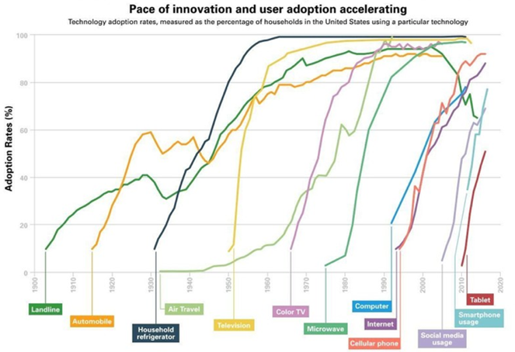
No longer an adoption curve - it’s an adoption rocket!
Notes:
getting faster and Faster
To guide our analysis, we had decide what emerging market would be the best fit and what time period,, Euler will work it through our methodology.

Slide 6
Kenya, Nigeria and Ghana as an SSA market benchmark
We evaluated African countries on three key dimensions impacting start-ups:
Citizen’s average ability to pay (PPP)
Disparity of wealth (Gini)
Country logistics performance (LPI)
Kenya, Nigeria and Ghana can, on average, be considered as representative of sub-Saharan countries
They make up 1/4 of Africa’s population, making them good launching pads for most African startups
These countries also have dynamic tech startup ecosystems
Kenya
Pop: 52M
PPP: $3,500
Gini: 40.8
LPI: 2.81
Ghana
Pop: 30M
PPP: $4,746
Gini: 43.5
LPI: 2.57
Nigeria
Pop: 200M
PPP: $5,900
Gini: 43
LPI: 1.97
Note: Pop: Total population (2019); PPP: Purchasing power parity (2017); Gini: Coefficient to measure income inequality (2009 - 2017); LPI: Logistics Performance Index (2018)
Notes:
To frame this, we had to find a time period that was suiting. To find this time period, we looked at where certain African countries are today, with wrt macroeconomic factors.
Logistics performance index:-is an interactive benchmarking tool created by the World Bank to help countries identify the challenges and opportunities they face in their performance on trade logistics and what they can do to improve their performance.It is analysed over 6 dimensions:The logistics performance (LPI) is the weighted average of the country scores on the six key dimensions:
The efficiency of the clearance process (i.e; speed, simplicity and predictability of formalities) by border control agencies, including customs.
Quality of trade and transport-related infrastructure (e.g., ports, railroads, roads, information technology);
Ease of arranging competitively priced shipments;
Competence and quality of logistics services (e.g., transport operators, customs brokers);
Ability to track and trace consignments;
Timeliness of shipments in reaching the destination within the scheduled or expected delivery time.
Mention Ethiopia and South Africa to say why they do not fit this “mold
Ethiopia is not a good fit due to its Low GDP per capita.
South africa is not a good fit due to its high variation income distribution, and it’s good infrastructure.
Looked at multiple countries to see what are representative
Dropped SA, high PPP and disparity, Botswana too small
These are representative,
In addition

Slide 7
2005 India was similar to Africa today on key macro indicators
2005 India, compared to Africa today had
Similar average ability to pay
Similar logistics capability
Lower income disparity
China:
Pop: 1.386B
PPP: 16,700
Gini: 38.6
LPI: 3.61
India
Pop: 1.33B
PPP: 7,200
Gini: 35.2
LPI: 3.18
Indonesia:
Pop: 264M
PPP: 12,400
Gini: 38.1
LPI: 3.15
Note: Pop: Total population (2019); PPP: Purchasing power parity (2017); Gini: Coefficient to measure income inequality (2009 - 2017); LPI: Logistics Performance Index (2018)
Notes:
In 2005, India was where African countries are now, which makes it interesting to look aroiund that time to guide or analysis.
Indonesia hasn't really caught up yet wrt VC funding
India is well ahead, Bengalore indian silicon valley with crazy volumes.
China is to special
Mention Ethiopia and South Africa to say why they do not fit this “mold
Ethiopia is not a good fit due to its Low GDP per capita.
South africa is not a good fit due to its high variation income distribution, and its good infrastracture
India 2005 had GINI of 34.4 & LPI of 3.27 (2007). LPI was higher in 2007 india than today.

Slide 8
Indian industries and enablers have evolved through time ...
 |  | <2000 | 2000-2005 | 2005-2010 | 2010-2015 | 2015-2020 | Grand Total
 | Commerce | 1 ($0.2B) | 2 ($4.5B) | 9 ($9.2B) | 11 ($4.9B) | 7 ($1.9B) | 30 ($20.7B)
 | Financial Services | 13 ($3.1B) | 3 ($1.2B) | 3 ($0.8B) | 3 ($1B) | 7 ($1B) | 29 ($7.1B)
 | Energy |  | 2 ($3.7B) |  | 1 ($2.8B) |  | 3 ($6.5B)
 | Transportation |  |  |  | 3 ($4.1B) | 1 ($0.1B) | 4 ($4.2B)
 | Travel & Tourism |  |  |  | 1 ($3.2B) |  | 1 ($3.2B)
 | Food and Beverage |  |  | 1 ($0.9B) | 2 ($2B) |  | 3 ($2.9B)
 | Logistics | 1 ($0.1B) |  |  | 3 ($1.8B) | 2 ($0.4B) | 6 ($2.3B)
 | Education | 1 ($0.2B) | 1 ($0B) |  | 2 ($1.5B) | 2 ($0.2B) | 6 ($1.9B)
 | Health Care | 3 ($0.5B) | 1 ($0.2B) | 2 ($0.3B) |  | 2 ($0.5B) | 8 ($1.5B)
 | Other | 8 ($0.9B) | 5 ($0.7B) | 5 ($0.5B) | 8 ($0.6B) | 4 ($0B) | 30 ($2.6B)
 | Tech (2g, 3g, etc.) | 2g | 2g | 2g, 3g | 2g, 3g, 4g | 2g, 3g, 4g
 | Mobile penetration | 0.3% | 8% | 61% | 76% | 87%
 | Smartphone penetration |  |  |  | 15% | 29%
 | Internet Access | 0.5% | 2.4% | 7.5% | 17% | 36%
 | LPI/infrastructure |  |  | 3.16 | 3.0 | 3.18
Industries
Enablers
= Kenya today
Notes:
Financial services received a lot of VC funding early on, implying that the financial infrastructure of the country was built out.
Financial infrastructure is a key enabler for ecommerce, which after 2000 received boomed. Many companies where founded received a lot of funding, across different verticals.
Market for non-commerce/finance exists, but smaller. Likely due to smaller market size ref VC model
spending power wise, we’re back today, but tech wise, we way ahead of India 2005. The fact taht Kenya is now at the same place as India techwise (4g, mobile penetration, internet access etc), enables different solutions to the same problems. enablers, we’re ahead wrt infrastructure -> leapfrogging.
A lot of ideas, but not a lot of money.
Logistics
e-commerce broad.

Slide 9
… as has funding towards towards $100m+ startups across verticals
< 2000
2005-2010
2015-2020
1. Financial Services - $3.1B
Distribution and supply chain solutions for I.T and consumer products.
Asset financing - commercial, housing and retail.
Banking and digital payments solutions.
2. Hardware - $603M
Mobile and telecommunication services.
3. Healthcare - $506M
Pathology services and radiology.
Healthcare provision: consultancy, insurance and pharmacy.
4. Manufacturing - $298M
Clothing and apparel, sports gear and wear
Manufacturing and sale of farming machinery, and plywood material.
1. Commerce - $10.2B
E-commerce: online shopping, buying and renting, travel booking, restaurant booking/reviewing and ticketing
Infrastructure equipment renting, servicing Construction, Energy, and Telecom
2. Financial services - $690M
Life insurance and general insurance comparison portal that analyzes financial and insurance products
Housing finance needs for the middle-income earning population bracket.
3. Advertising - $320M
Advertising Platforms, Digital Media, Marketing, Mobile.
4. Healthcare - $290M
Lifestyle and chronic disease-pharma, and online booking of doctors/telemedicine
1. Commerce - $1.86B
Marketplaces across cars, agriculture, and social commerce for SMB.
B2B trade platforms consolidating value chains
2. Financial services - $1B
Cashback and reward apps, online insurance and payment solutions for corporates
3. Healthcare - $500M
Digital consumer healthcare platform and pharmacy aggregator
4. Logistics- $382M
Hyperlocal deliveries and Uber for trucking deliveries
2000
2005
2010
2015
2020
2000-2005
2010-2015
1. Commerce - $6.75B
Marketplaces for freelancers, used cars / bikes, furniture, eyewear and general online shopping
On-demand food delivery
2. Transportation - $4.3B
Bike sharing and rentals, peer-to-peer car sharing and ridehailing
3. Energy - $2.7B
Renewable energy (wind, solar and hydro)
4. Travel & Tourism - $3.2B
Budget-friendly hotel chain
1. Commerce - $4.7B
Mobile services - telecom applications, cloud platform.
Electronic payment services
2. Renewable Energy $ 3.7B
Hydro, biomass and wind energy.
3. Financial services - $952M
General insurance to individuals and businesses.
Life insurance plans and policies.
4. Information technology - $381M
Digitalization across financial, transport, logistics, travel and insurance.
Notes:
Clear each box.
in 2000, a lot of brick and mortar
2010, marketplaces for freelances, used/cars bikes, furniture, eyewear
2015-2020, marketplaces for cars, agri, social commerce for SMB. digitalizing whatever they built in 2000.
It’s reasonable to believe, that in 5-10 years, every single one of these startups have a major African counterpart, solving the same problem across countries in Africa.
These are problems that were valuable to solve
There’s definitly trends and successions.
Should we look at alternative ways of solving the issues? Yes. Leapfrogging. Good startups shows us where there are problems. We can use that as inspiration.
With caution
Right now, f.ex Jumia is trying to solve the bare minimum of e-commerce. General online shopping. What they founded in early 2005’s, shortly after, other commerce sites started popping up i.e travel booking, restaurant booking/reviewing,
Key takeaway is: can we look at India and find problems worht solving and solutions to these problems. Answer is YES.
This is a high-level overview of where VC money went.
They have put money into solving similar issues to what companies in Africa is trying to solve - definitely exists more similar problems.
Looking at this a bit more granularly.
Energy, travel & tourism
- Highest fund raised per 5-year period and a brief description of startup
<2000
1.Tata teleservices - focused on the telecommunications sector
2.Apollo Hospitals Enterprise-a premium multi-specialty hospital of India and is one of the largest integrated healthcare groups.
3.PNB Housing Finance- India's home loan provider from last 25 years offering home loans at fixed & flexible rate of Interest.
4.Capital Small Finance Bank- Small finance bank Company.
5.Hero FinCorp-is a financial company present across categories like two-wheeler financing, supply chain finance and business loans.
6.Five Star Business Finance-is a Registered Non Banking Finance Company (NBFC) with Reserve Bank of India (RBI).
7.Kalyan Jewellers-The group derives its origins from textile retailing and wholesaling and has an experience of over 100 years in the trade.
8.Aakash Educational Services-It is a conglomerate that offers educational services across India
2000-2005
1.One97- delivers mobile content and commerce services to its customers.
2.BillDesk- was conceived in early 2000 to solve the frustrations of most of us when it comes to payments.
3.Stovekraft-Is the largest Kitchen Appliances company in the Indian kitchen appliances industry.
4.Greenko Group-Greenko Group, based in India, is an independent power producer developing clean energy assets.
5.CLP India Pvt. Ltd. -is a foreign investor in the Indian power sector.
6.Royal Sundaram provides comprehensive insurance plans and innovative insurance solutions to individuals, families and businesses.
7.SBI Life - Is one of the life insurance company that offers a range of life insurance plans and policies to protect you and your family.
8.NIIT Technologies- Is a leading IT solutions organization, servicing customers in North America, Europe, Asia and Australia.
2005-2010
1.Quippo Infrastructure- is an equipment rental company servicing the high growth verticals of construction, telecom, energy, and oil and gas.
2.Flipkart- owns and operates an online shopping website with a registered customer base of over 100 million.
3.Quikr- Is a free classifieds and online marketplace that helps users to sell, buy, rent, or discover anything across India.
4.Zomato- designs a web and mobile-based restaurant search, ordering, and discovery platform that searches and reviews restaurants.
5.PolicyBazaar- designs an online life insurance and general insurance comparison portal that analyzes financial products.
6.Aptus Value Housing Finance - Aptus is a company engaged in Affordable housing finance
7.InMobi - Develops an advertisement serving algorithm that helps in optimizing the ranking of the advertisements served on mobile phones.
8. Eris Lifesciences - Is a domestic pharmaceutical company in India that focuses on the chronic and lifestyle diseases segment.
9.DailyHunt develops mobile application software.
Pre 2000, VC funding went primarily to Financial services. Not only payments infrastructure, but across value chain and basic credit solutions.
This continued between 2000-2005, along with Commerce, where it started to grow. vad gjordes 2000-2005

Slide 10
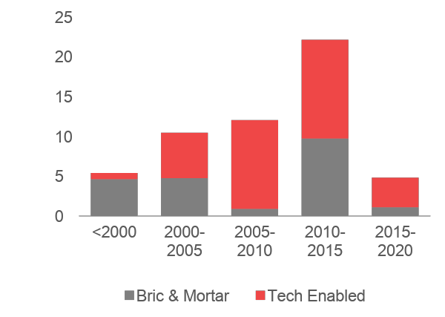
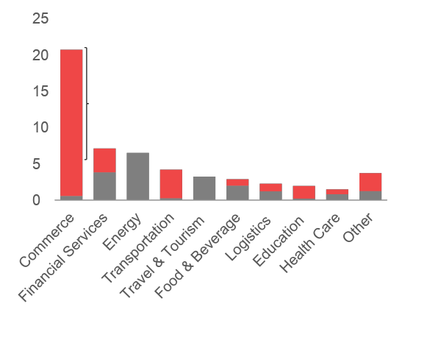
Evolution of tech investments
Evolution of Investment Trends ($B)
Investment by Sector to Date ($B)
- Flipkart ($7.7B)
- One97 ($4.4B)
- Snapdeal ($1.8B)
- BigBasket ($1.0B)
-Udaan ($0.9B)
Notes:
Brick and mortar vs tech, over time
For india, in 2005, when tech took off, all else equal, you’re at the right moment in the wave
2005-2010: tech startups founded there, still raised money. need to be resilient
Graph not necessarily tells you this since the companies founded in 2010/2015 hasn't managed to raise enough yet)
Investment by sector pre2020, ordered from highest to lowest
Commerce receives a inproportionate share of VC funding.
Flipkart, Snapdeal, general online shopping
Big Basket, online grocery shopping
One97, finance app / superapp/commerce
Udaan - b2b trading platform
As consumer behaviour changes and tech improves, more and more VC funding goes into tech enabled businesses rather than traditional brick and mortar (g

Slide 11
We do not always have to
reinvent the wheel ...
Sometimes we can localize big ideas and be ahead of the
“global game”
Notes:
There are definitely trends and similarities. Thus we can look at what problems were most valuable to solve, look at the solution, and adapt it to Africa’s context. -> there will be major african counterparts to these problems, given taht the same problems exists here as well.
This is called importing product/market fit. you know that a product has solved a similar problem in a different market. -> caution. blind clones doesn't work.

Slide 12

Careem was set up in Dubai, United Arab Emirates, in 2012. It has around one million drivers and is available in 90 cities in 15 countries, stretching from Algeria to Pakistan
Acquired by Uber for $3.1 billion
How did Careem “win” the Middle Eastern market?
Drivers called Captains (rather than drivers) to increase the prestige of the job
Cash functionality (vs. credit card only)
Better local street mapping
Notes:
When importing product market fit, important ocnsideratoins:
Uber failed because of no localization.
Careem succeeded because of localization,
Want you
---
When looking to other emerging markets, what are some things to think about? Both, what are good types of businesses to get inspired by, and implicitly, what affects scalability of it?
Localization is important, as example suggests. One important aspect: need to solve more than one problem when value chains are broken. You heard Peter from Twigas speech. Moreover, Lori systems example.
But different types of businesses:
Regulated startups:
In general, any startup that is affected by regulation is a very clonable target, as solving those problems in every country of the world is extremely hard and they’d love to have someone do it for them.
Stripe went through hell in the US to launch.
If you can solve the regulatory problems for them, they will acquire you very gladly.
Uber is a different example of a regulated startup.
E-commerce: intrinsically local. For example, there was space to create amazon.com in every country before theyexpanded, and there are countries where it has been done. You need to source products, handle logistics and shipping, customer support, etc. and all these activities are local.
Deeply local startups:
requires deep integratoin with local consumer and business community. GroupOn, Opentable, Taskrabbit (Lynk)
Consumer internet: usually a more winner-takes all kind of market. Instagram, Pinterest. can scale extremely fast across borders and thus difficult to fight against.

Slide 13
www.antler.co
Notes:
We dont want people to copy paste, not just take a list of startups. Not look at solutions.
Think about the problems, they persist across geographies

Slide 14



























Evolution of $100M+ start-up sectors in India pre-2010
Melalite: separate brick and mortar into “techable
Euler: separate b2c vs b2b (last task)
Melalite: What are things that are growing fast in india / indonesia / china
Marie: add conceptual elements -> DONE
Marie: Kareem example in Asia for success -> DONE
Find a failure example of non-localization -> Think this can be Uber in the same case (AAB: Agree)
Adrian : Executive summary finish (Marie to help)
Observations
Add logos that are missing
Total investment per 5 year period
Duplicate this slide to say how many are tech enabled
Take away categories that aren’t tech enabled in the duplicate
Add 2010 - 2015 and 2015 - 2020, change to a table (order by amount invested)
Commerce (2)
Financial Services (2)
Health Care (1)
Content and Publishing (1)
Information Technology (1)
Data and Analytics (1)
Clothing and Apparel (1)
Total funding amount - $10.47B
2000 - 2005
<2000
2005 - 2010
Financial Services (14)
Manufacturing (4)
Health Care (3)
Commerce (1)
Hardware (1)
Internet Services (1)
Clothing and Apparel (1)
Social Media (1)
Education (1)
Total funding amount - $5.4B
Commerce (10)
Software (2)
Health Care (2)
Financial Services (2)
Food and Beverage (2)
Community and Lifestyle (1)
Content and Publishing (1)
Advertising (1)
Total funding amount - $12.05B
Notes:
- Highest fund raised per 5-year period and a brief description of startup
<2000
1.Tata teleservices - focused on the telecommunications sector
2.Apollo Hospitals Enterprise-a premium multi-specialty hospital of India and is one of the largest integrated healthcare groups.
3.PNB Housing Finance- India's home loan provider from last 25 years offering home loans at fixed & flexible rate of Interest.
4.Capital Small Finance Bank- Small finance bank Company.
5.Hero FinCorp-is a financial company present across categories like two-wheeler financing, supply chain finance and business loans.
6.Five Star Business Finance-is a Registered Non Banking Finance Company (NBFC) with Reserve Bank of India (RBI).
7.Kalyan Jewellers-The group derives its origins from textile retailing and wholesaling and has an experience of over 100 years in the trade.
8.Aakash Educational Services-It is a conglomerate that offers educational services across India
2000-2005
1.One97- delivers mobile content and commerce services to its customers.
2.BillDesk- was conceived in early 2000 to solve the frustrations of most of us when it comes to payments.
3.Stovekraft-Is the largest Kitchen Appliances company in the Indian kitchen appliances industry.
4.Greenko Group-Greenko Group, based in India, is an independent power producer developing clean energy assets.
5.CLP India Pvt. Ltd. -is a foreign investor in the Indian power sector.
6.Royal Sundaram provides comprehensive insurance plans and innovative insurance solutions to individuals, families and businesses.
7.SBI Life - Is one of the life insurance company that offers a range of life insurance plans and policies to protect you and your family.
8.NIIT Technologies- Is a leading IT solutions organization, servicing customers in North America, Europe, Asia and Australia.
2005-2010
1.Quippo Infrastructure- is an equipment rental company servicing the high growth verticals of construction, telecom, energy, and oil and gas.
2.Flipkart- owns and operates an online shopping website with a registered customer base of over 100 million.
3.Quikr- Is a free classifieds and online marketplace that helps users to sell, buy, rent, or discover anything across India.
4.Zomato- designs a web and mobile-based restaurant search, ordering, and discovery platform that searches and reviews restaurants.
5.PolicyBazaar- designs an online life insurance and general insurance comparison portal that analyzes financial products.
6.Aptus Value Housing Finance - Aptus is a company engaged in Affordable housing finance
7.InMobi - Develops an advertisement serving algorithm that helps in optimizing the ranking of the advertisements served on mobile phones.
8. Eris Lifesciences - Is a domestic pharmaceutical company in India that focuses on the chronic and lifestyle diseases segment.
9.DailyHunt develops mobile application software.

Slide 15



Evolution of $100M+ tech-enabled sectors in India pre-2010
Observations
Add logos that are missing
Total investment per 5 year period
Duplicate this slide to say how many are tech enabled
Take away categories that aren’t tech enabled in the duplicate
Questionable if/how we keep this
Commerce (2)
Financial Services (2)
Health Care (1)
Content and Publishing (1)
Information Technology (1)
Data and Analytics (1)
Total funding amount - $5.7B
2000 - 2005
<2000
2005 - 2010
Financial Services (14)
Commerce (1)
Internet Services (1)
Social Media (1)
Total funding amount - $ 0.79B
Commerce (10)
Software (2)
Health Care (2)
Financial Services (2)
Food and Beverage (2)
Community and Lifestyle (1)
Content and Publishing (1)
Advertising (1)
Total funding amount - $11.6B
Notes:
- Highest fund raised per 5-year period and a brief description of startup
<2000
1.Tata teleservices - focused on the telecommunications sector
2.Apollo Hospitals Enterprise-a premium multi-specialty hospital of India and is one of the largest integrated healthcare groups.
3.PNB Housing Finance- India's home loan provider from last 25 years offering home loans at fixed & flexible rate of Interest.
4.Capital Small Finance Bank- Small finance bank Company.
5.Hero FinCorp-is a financial company present across categories like two-wheeler financing, supply chain finance and business loans.
6.Five Star Business Finance-is a Registered Non Banking Finance Company (NBFC) with Reserve Bank of India (RBI).
7.Kalyan Jewellers-The group derives its origins from textile retailing and wholesaling and has an experience of over 100 years in the trade.
8.Aakash Educational Services-It is a conglomerate that offers educational services across India
2000-2005
1.One97- delivers mobile content and commerce services to its customers.
2.BillDesk- was conceived in early 2000 to solve the frustrations of most of us when it comes to payments.
3.Stovekraft-Is the largest Kitchen Appliances company in the Indian kitchen appliances industry.
4.Greenko Group-Greenko Group, based in India, is an independent power producer developing clean energy assets.
5.CLP India Pvt. Ltd. -is a foreign investor in the Indian power sector.
6.Royal Sundaram provides comprehensive insurance plans and innovative insurance solutions to individuals, families and businesses.
7.SBI Life - Is one of the life insurance company that offers a range of life insurance plans and policies to protect you and your family.
8.NIIT Technologies- Is a leading IT solutions organization, servicing customers in North America, Europe, Asia and Australia.
2005-2010
1.Quippo Infrastructure- is an equipment rental company servicing the high growth verticals of construction, telecom, energy, and oil and gas.
2.Flipkart- owns and operates an online shopping website with a registered customer base of over 100 million.
3.Quikr- Is a free classifieds and online marketplace that helps users to sell, buy, rent, or discover anything across India.
4.Zomato- designs a web and mobile-based restaurant search, ordering, and discovery platform that searches and reviews restaurants.
5.PolicyBazaar- designs an online life insurance and general insurance comparison portal that analyzes financial products.
6.Aptus Value Housing Finance - Aptus is a company engaged in Affordable housing finance
7.InMobi - Develops an advertisement serving algorithm that helps in optimizing the ranking of the advertisements served on mobile phones.
8. Eris Lifesciences - Is a domestic pharmaceutical company in India that focuses on the chronic and lifestyle diseases segment.
9.DailyHunt develops mobile application software.

Slide 16
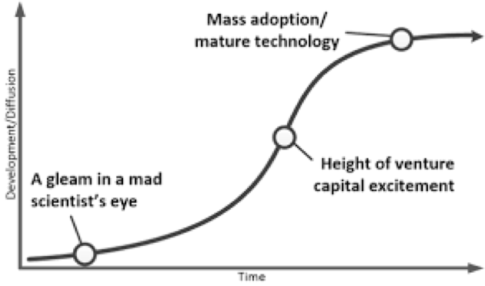
At what time is a market “ready” to take off?

Slide 17
Context: Status of infrastructure and technology of India in 2005
Enablers
Tech (2g, 3g, fixed line):
Mobile phone penetration
Smartphone penetration
Internet Access
LPI/Physical infrastructure:
Hilight where Africa is on each metric compared to India by Year

Slide 18
Asia: Select Countries & Macro-Economic Indicators
Action titles
Need to explain why we using 4700 as a benchmark notes possibly
Clean up redbox?
China:
Pop: 1.386B
PPP: 16,700
Gini: 38.6
LPI: 3.61
Year when PPP was ~$4,715:
India: 2004
China: 2005
Indonesia: 2000
Indonesia:
Pop: 264M
PPP: 12,400
Gini: 38.1
LPI: 3.15
Indicators
Pop: Total population (2019)
PPP: Purchasing power parity (2017)
Gini: Coefficient to measure income inequality (2009 - 2017)
LPI: Logistics Performance Index (2018)
India
Pop: 1.33B
PPP: 7,200
Gini: 35.2
LPI: 3.18

Slide 19
Africa: Select Countries & Macro-Economic Indicators
Average* Country Profile:
PPP: $4,715
GINI: 42.43
LPI: 2.45
Total Pop: ~ 282 M
Kenya
Pop: 52M
PPP: $3,500
Gini: 40.8
LPI: 2.81
Ghana
Pop: 30M
PPP: $4,746
Gini: 43.5
LPI: 2.57
Nigeria
Pop: 200M
PPP: $5,900
Gini: 43
LPI: 1.97
Indicators
Pop: Total population (2019)
PPP: Purchasing power parity (2017)
Gini: Coefficient to measure income inequality (2009 - 2017)
LPI: Logistics Performance Index (2018)
Notes:
Mention Ethiopia and South Africa to say why they do not fit this “mold
Ethiopia is not a good fit due to its Low GDP per capita.
South africa is not a good fit due to its high variation income distribution, and its good infrastracture

Slide 20
Asia: Select Countries & Macro-Economic Indicators
Action titles
Need to explain why we using 4700 as a benchmark notes possibly
Clean up redbox?
China:
Pop: 1.386B
PPP: 16,700
Gini: 38.6
LPI: 3.61
Year when PPP was ~$4,715:
India: 2004
China: 2005
Indonesia: 2000
Indonesia:
Pop: 264M
PPP: 12,400
Gini: 38.1
LPI: 3.15
Indicators
Pop: Total population (2019)
PPP: Purchasing power parity (2017)
Gini: Coefficient to measure income inequality (2009 - 2017)
LPI: Logistics Performance Index (2018)
India
Pop: 1.33B
PPP: 7,200
Gini: 35.2
LPI: 3.18

Slide 21
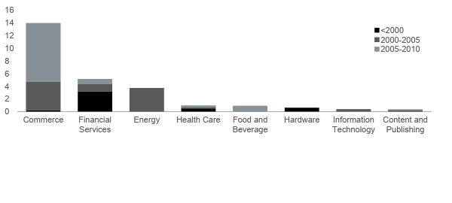
Melalite to add years till 2020
Indian Start-up Sectors by Total Investment Pre 2010

Slide 22
So …..
Attitudes
Willingness to pay for daata
Desire to use tech services
Enablers
Mobile payment
Logistics
Data infrastructure
Regulators
….

Slide 23
Have
Emerging
Dont have

Slide 24
Emerging Market / Inspiration Ideas
industry 1

Slide 25
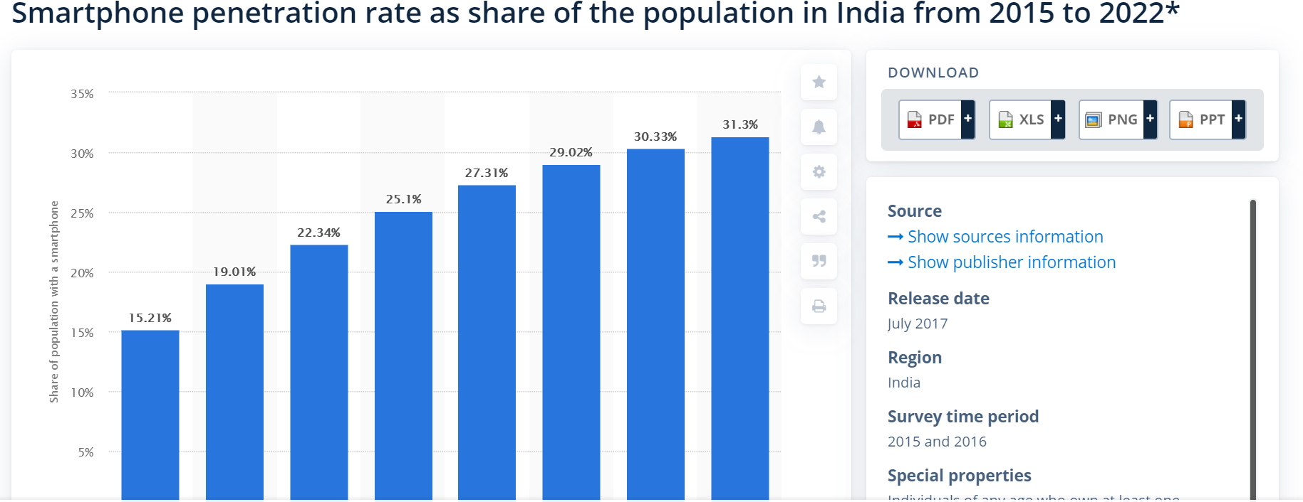
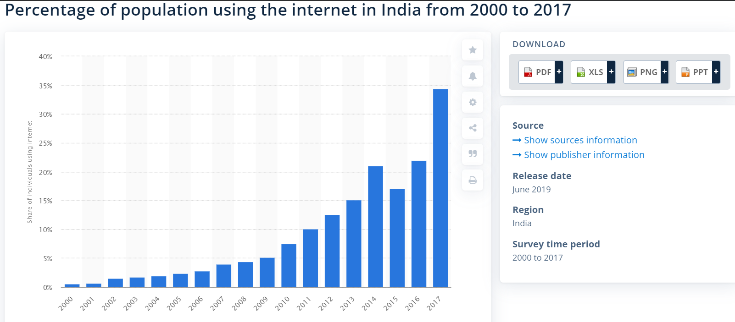
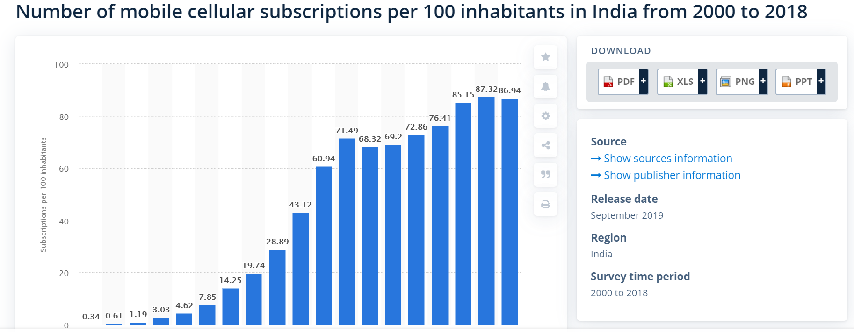

Slide 26
Africa: Select Countries & Macro-Economic Indicators
Average* Country Profile:
PPP: $4,715
GINI: 42.43
LPI: 2.45
Total Pop: ~ 282 M
Kenya
Pop: 52M
PPP: $3,500
Gini: 40.8
LPI: 2.81
Ghana
Pop: 30M
PPP: $4,746
Gini: 43.5
LPI: 2.57
Nigeria
Pop: 200M
PPP: $5,900
Gini: 43
LPI: 1.97
Indicators
Pop: Total population (2019)
PPP: Purchasing power parity (2017)
Gini: Coefficient to measure income inequality (2009 - 2017)
LPI: Logistics Performance Index (2018)
Notes:
Mention Ethiopia and South Africa to say why they do not fit this “mold
Ethiopia is not a good fit due to its Low GDP per capita.
South africa is not a good fit due to its high variation income distribution, and its good infrastracture

Slide 27
Make bullets more descriptive
Recategorize things like IT to be FS
adjust numbering for the first box to be 1 - 4
Summary : What were they doing in each ½ decade
Adrian: summary for every 5 years saying: wehat did they do in summary
Where did most anticipated* value come from?
< 2000
2000 - 2005
2005 - 2010
1. Financial Services - $3.1B
Distribution and supply chain solutions for I.T and consumer products.
Asset financing - provision of commercial, housing and retail loans.
Banking and digital payments solutions.
2. Hardware - $603M
Mobile and telecommunication services.
3. Health Care - $506M
Pathology services and radiology.
Healthcare provision: consultancy, insurance and pharmacy.
4. Manufacturing - $298M
Textile: clothing and apparel
Manufacturing and sale of farming machinery.
Manufacturing and sale of plywood products to different sectors.
Sports gear and wear
1. Commerce - $4.7B
Mobile services - telecom applications, cloud platform.
Electronic payment services
2. Renewable Energy $ 3.7B
Hydro, biomass and wind energy.
3. Financial services - $952M
General Insurance to individuals and businesses.
Life insurance plans and policies.
4. Information technology - $381M
Analytics, Cloudification, Cognitive automation, and Digitalization in provision of I.T solutions across financial, transport, logistics, travel and insurance.
1. Commerce - $9.3B
E-commerce-online shopping,buying and renting, travel booking and ticketing
Infrastructure equipment renting, servicing the high growth verticals of Construction, Oil & Gas, Telecom and Energy.
Food and Beverage - $909M
A web and mobile-based restaurant search, ordering, and discovery platform that searches and reviews restaurants.
Financial services - $690M
Life insurance and general insurance comparison portal that analyzes financial and insurance products .
Housing finance needs for the middle income earning population bracket.
4. Advertising - $320M
Advertising, Advertising Platforms, Digital Media, Marketing, Mobile.
Summary
Summary
* Total funding amount

Slide 28
Make bullets more descriptive
Recategorize things like IT to be FS
adjust numbering for the first box to be 1 - 4
Summary : What were they doing in each ½ decade
Adrian: summary for every 5 yaers saying: wehat did they do in summary
Where did most anticipated* value come from?
< 2000
2000-2005
2005-2010
< 2000
1. Financial Services - $3.1B
Distribution and supply chain solutions for I.T and consumer products.
Asset financing - commercial, housing and retail.
Banking and digital payments solutions.
2. Hardware - $603M
Mobile and telecommunication services.
3. Healthcare - $506M
Pathology services and radiology.
Healthcare provision: consultancy, insurance and pharmacy.
4. Manufacturing - $298M
Clothing and apparel, sports gear and wear
Manufacturing and sale of farming machinery, and plywood material.
1. Commerce - $4.7B
Mobile services - telecom applications, cloud platform.
Electronic payment services
2. Renewable Energy $ 3.7B
Hydro, biomass and wind energy.
3. Financial services - $952M
General insurance to individuals and businesses.
Life insurance plans and policies.
4. Information technology - $381M
Analytics, Cloudification, Cognitive automation, and Digitalization in provision of I.T solutions across financial, transport, logistics, travel and insurance.
1. Commerce - $9.3B
E-commerce: online shopping, buying and renting, travel booking and ticketing
Infrastructure equipment renting, servicing Construction, Energy, and Telecom and
Food and Beverage - $909M
A web and mobile-based restaurant search, ordering, and discovery platform that searches and reviews restaurants.
Financial services - $690M
Life insurance and general insurance comparison portal that analyzes financial and insurance products .
Housing finance needs for the middle income earning population bracket.
4. Advertising - $320M
Advertising Platforms, Digital Media, Marketing, Mobile.
Summary
Summary
* Total funding amount
1. Financial Services - $3.1B
Distribution and supply chain solutions for I.T and consumer products.
Asset financing - commercial, housing and retail.
Banking and digital payments solutions.
2. Hardware - $603M
Mobile and telecommunication services.
3. Healthcare - $506M
Pathology services and radiology.
Healthcare provision: consultancy, insurance and pharmacy.
4. Manufacturing - $298M
Clothing and apparel, sports gear and wear
Manufacturing and sale of farming machinery, and plywood material.

